Slide 1
Pt40Au60_AgBP2_hollow_shell_XA>XAP
2023-09-18

Slide 2
Input Parameters for DecomNano
Input Parameters (All) 8 data
Input Parameters (Droped parameters with no answer) 8 data
Parameter | Min | Max | Mean | Standard Deviation
dP | 2.8 | 2.8 | 2.8 | 0.0
dA | 2.9 | 2.9 | 2.9 | 0.0
fA | 0.6 | 0.6 | 0.6 | 0.0
nAA | 5.6 | 6.0 | 5.8 | 0.1
nPP | 11.1 | 11.3 | 11.1 | 0.1
nAP | 0.6 | 1.2 | 0.9 | 0.2
nPA | 0.4 | 0.8 | 0.6 | 0.1
DA | 20 | 20 | 20.0 | 0.0
DAP | 34 | 34 | 34.0 | 0.0
DP | 0 | 32 | 10.0 | 13.9
DAPh | 4 | 16 | 12.5 | 5.0
Parameter | Min | Max | Mean | Standard Deviation
dP | 2.8 | 2.8 | 2.8 | 0.0
dA | 2.9 | 2.9 | 2.9 | 0.0
fA | 0.6 | 0.6 | 0.6 | 0.0
nAA | 5.6 | 6.0 | 5.8 | 0.1
nPP | 11.1 | 11.3 | 11.1 | 0.1
nAP | 0.6 | 1.2 | 0.9 | 0.2
nPA | 0.4 | 0.8 | 0.6 | 0.1
DA | 20 | 20 | 20.0 | 0.0
DAP | 34 | 34 | 34.0 | 0.0
DP | 0 | 32 | 10.0 | 13.9
DAPh | 4 | 16 | 12.5 | 5.0

Slide 3
Ouput Parameters
Parameter | Min | Max | Mean | Standard Deviation
dP | 2.8 | 2.8 | 2.8 | 0.0
dA | 2.9 | 2.9 | 2.9 | 0.0
fA | 0.6 | 0.6 | 0.6 | 0.0
nAA | 5.6 | 6.0 | 5.8 | 0.1
nPP | 11.1 | 11.3 | 11.1 | 0.1
nAP | 0.6 | 1.2 | 0.9 | 0.2
nPA | 0.4 | 0.8 | 0.6 | 0.1
DA | 20 | 20 | 20.0 | 0.0
DAP | 34 | 34 | 34.0 | 0.0
DP | 0 | 32 | 10.0 | 13.9
DAPh | 4 | 16 | 12.5 | 5.0
nAM_AP | 2.4 | 4.7 | 3.8 | 0.8
nPM_AP | 11.7 | 12.0 | 11.9 | 0.1
nAA_AP | 0.8 | 2.2 | 1.8 | 0.5
nAP_AP | 1.4 | 2.6 | 2.0 | 0.5
nPA_AP | 0.5 | 0.8 | 0.7 | 0.1
nPP_AP | 11.1 | 11.5 | 11.2 | 0.1
XAP | 0.4 | 0.49 | 0.46 | 0.03
XA | 0.5 | 0.55 | 0.52 | 0.02
XP | 0.0 | 0.06 | 0.01 | 0.02
y | 0.24 | 0.27 | 0.26 | 0.01
dAP | 2.8 | 2.8 | 2.8 | 0.0
nMM_AP | 10.6 | 10.6 | 10.6 | 0.0
nAA_A | 9.8 | 9.8 | 9.8 | 0.0
nPP_P | 0.0 | 10.6 | 5.0 | 4.5
NA | 213.6 | 213.6 | 213.6 | 0.0
NP | 1.0 | 831.4 | 213.4 | 381.5
NAP | 920.6 | 920.6 | 920.6 | 0.0
XA*NA | 107.1 | 116.9 | 111.6 | 3.6
XP*NP | 0.0 | 51.1 | 9.0 | 18.5
XAP*NAP | 367.4 | 455.1 | 427.5 | 31.5
frac_XA*NA | 0.19 | 0.22 | 0.2 | 0.01
frac_XP*NP | 0.0 | 0.1 | 0.02 | 0.03
frac_XAP*NAP | 0.69 | 0.81 | 0.78 | 0.04
frac_Pt_P | 0.0 | 0.16 | 0.03 | 0.06
frac_Pt_PA | 0.84 | 1.0 | 0.97 | 0.06

Slide 4
Solution of DecomNano
Parameter | Min | Max | Mean | Standard Deviation
nAM_AP | 2.4 | 4.7 | 3.8 | 0.8
nPM_AP | 11.7 | 12.0 | 11.9 | 0.1
nAA_AP | 0.8 | 2.2 | 1.8 | 0.5
nAP_AP | 1.4 | 2.6 | 2.0 | 0.5
nPA_AP | 0.5 | 0.8 | 0.7 | 0.1
nPP_AP | 11.1 | 11.5 | 11.2 | 0.1
XAP | 0.4 | 0.49 | 0.46 | 0.03
XA | 0.5 | 0.55 | 0.52 | 0.02
XP | 0.0 | 0.06 | 0.01 | 0.02
y | 0.24 | 0.27 | 0.26 | 0.01

Slide 5
Other Parameters Calculated in the DecomNano
Parameter | Min | Max | Mean | Standard Deviation
dAP | 2.8 | 2.8 | 2.8 | 0.0
nMM_AP | 10.6 | 10.6 | 10.6 | 0.0
nAA_A | 9.8 | 9.8 | 9.8 | 0.0
nPP_P | 0.0 | 10.6 | 5.0 | 4.5
NA | 213.6 | 213.6 | 213.6 | 0.0
NP | 1.0 | 831.4 | 213.4 | 381.5
NAP | 920.6 | 920.6 | 920.6 | 0.0

Slide 6
Extracted Parameter Related to Hetereogeneity
Parameter | Min | Max | Mean | Standard Deviation
XA*NA | 107.1 | 116.9 | 111.6 | 3.6
XP*NP | 0.0 | 51.1 | 9.0 | 18.5
XAP*NAP | 367.4 | 455.1 | 427.5 | 31.5
y | 0.24 | 0.27 | 0.26 | 0.01
nAM_AP | 2.4 | 4.7 | 3.8 | 0.8
nPM_AP | 11.7 | 12.0 | 11.9 | 0.1

Slide 7
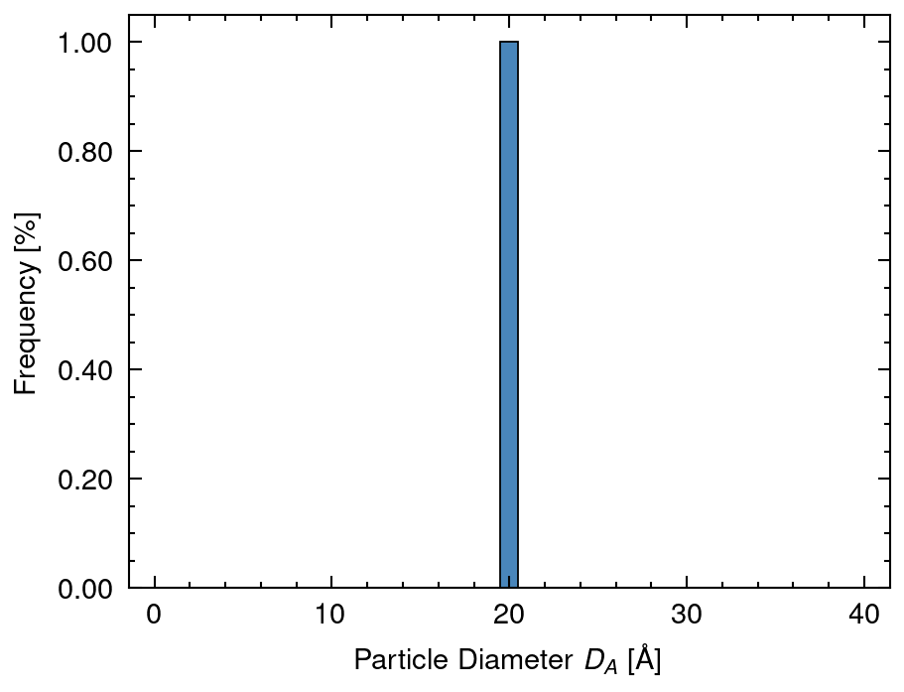
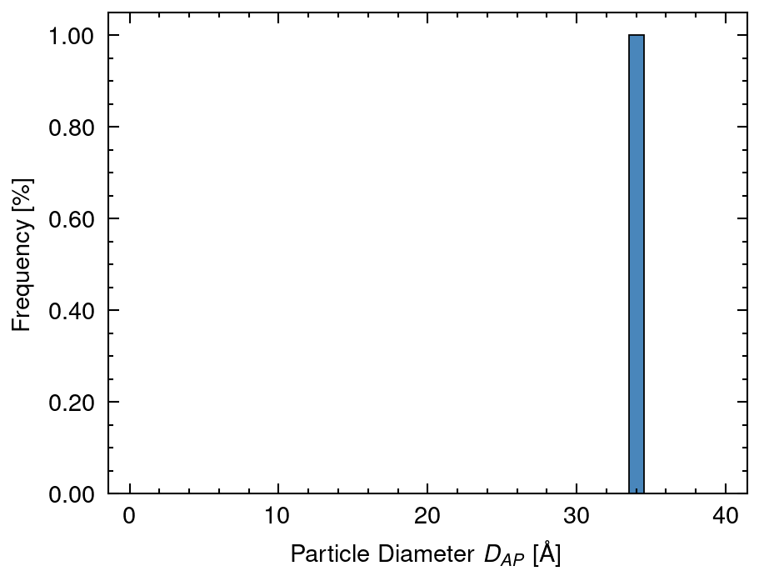
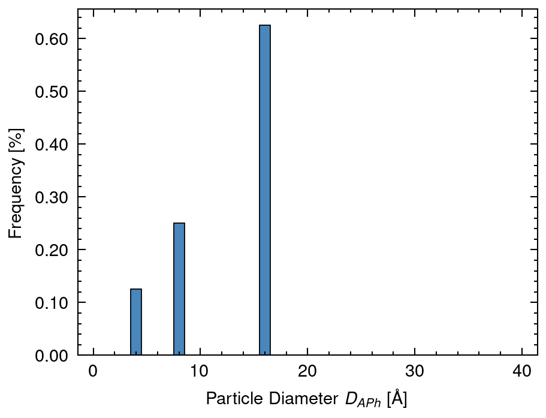
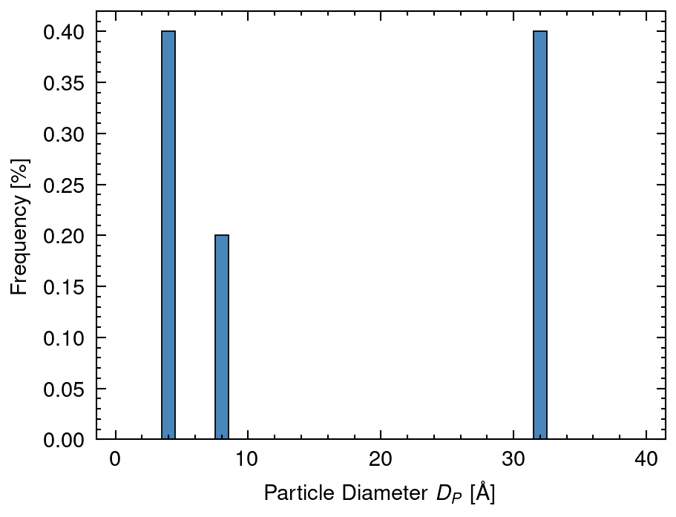
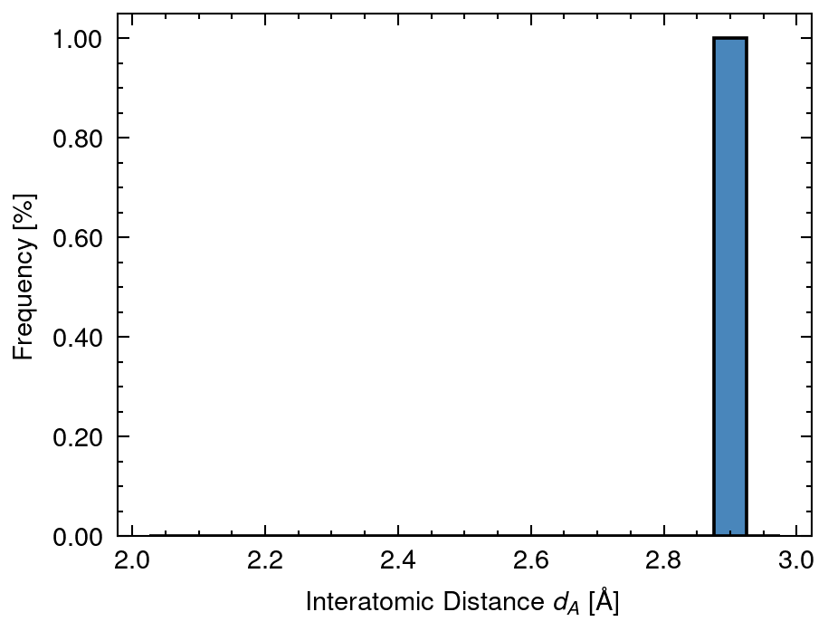
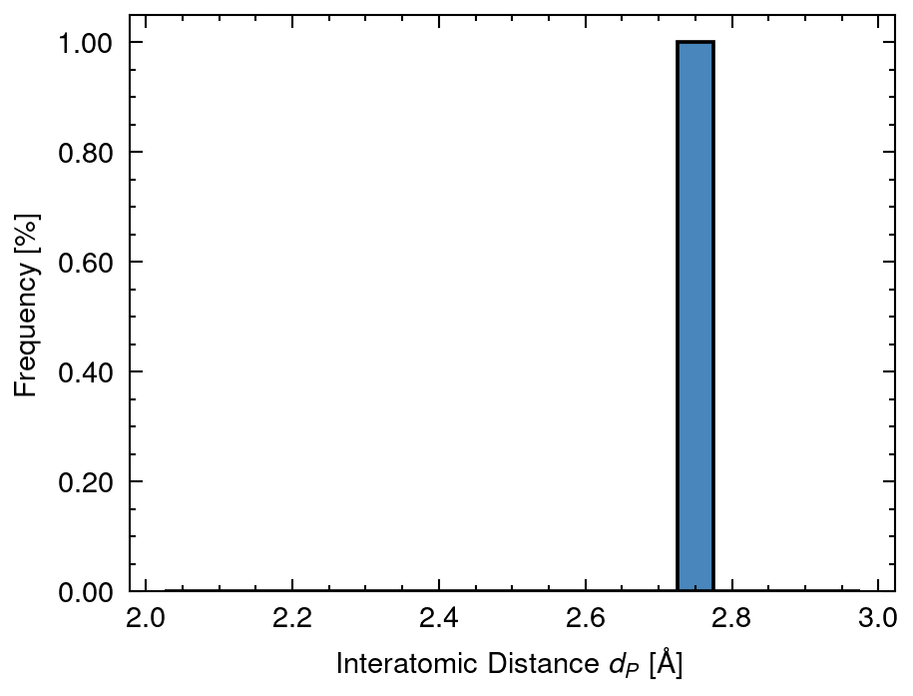
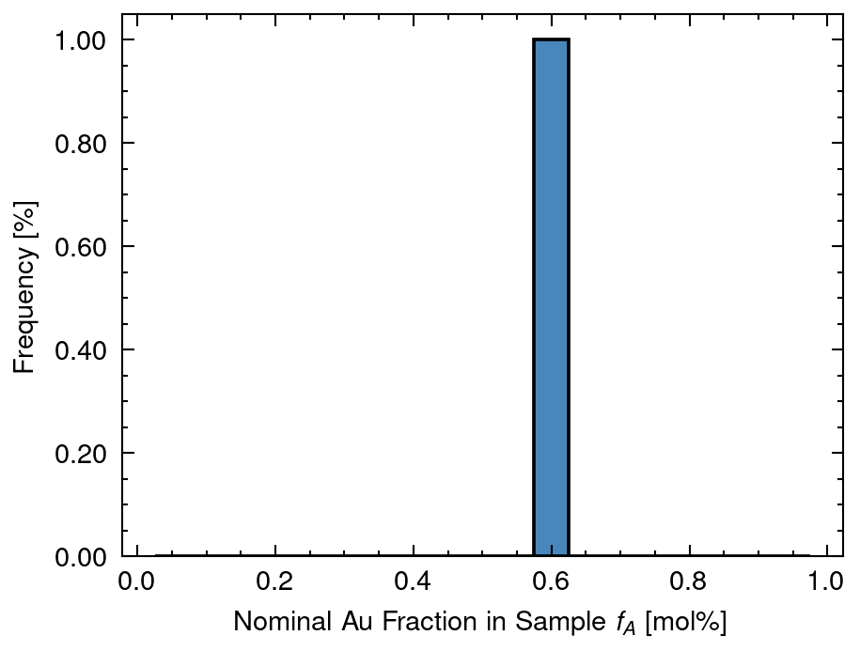
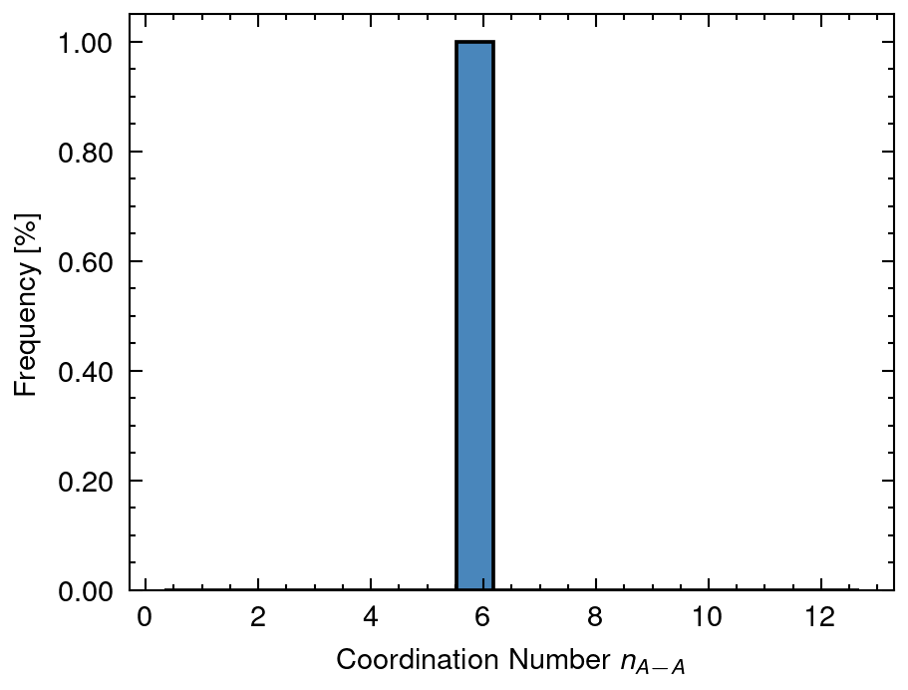
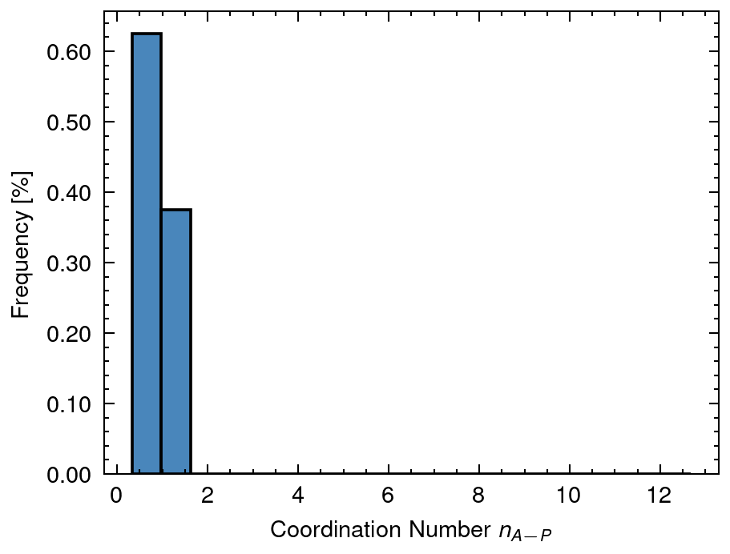
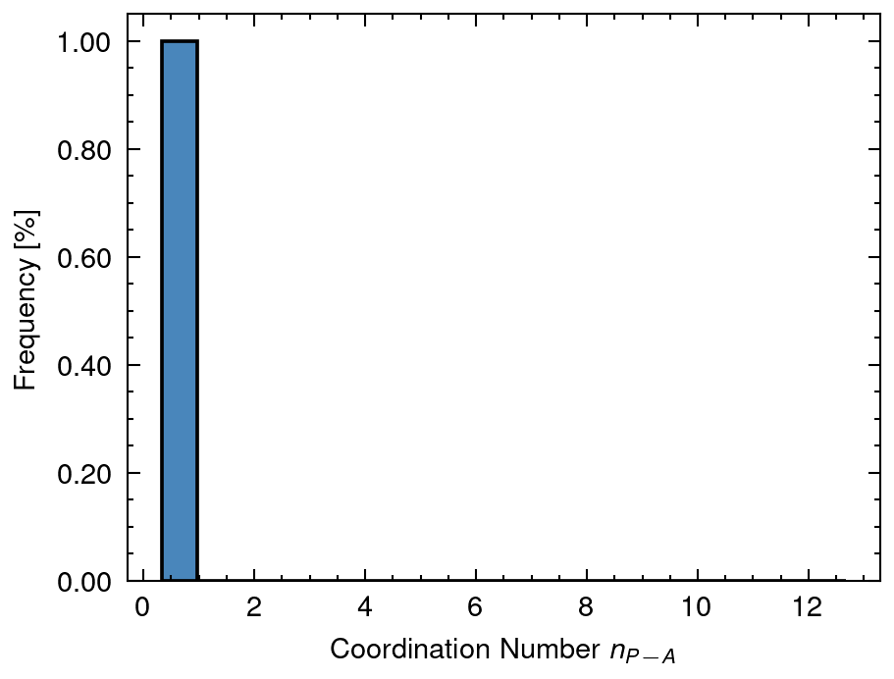
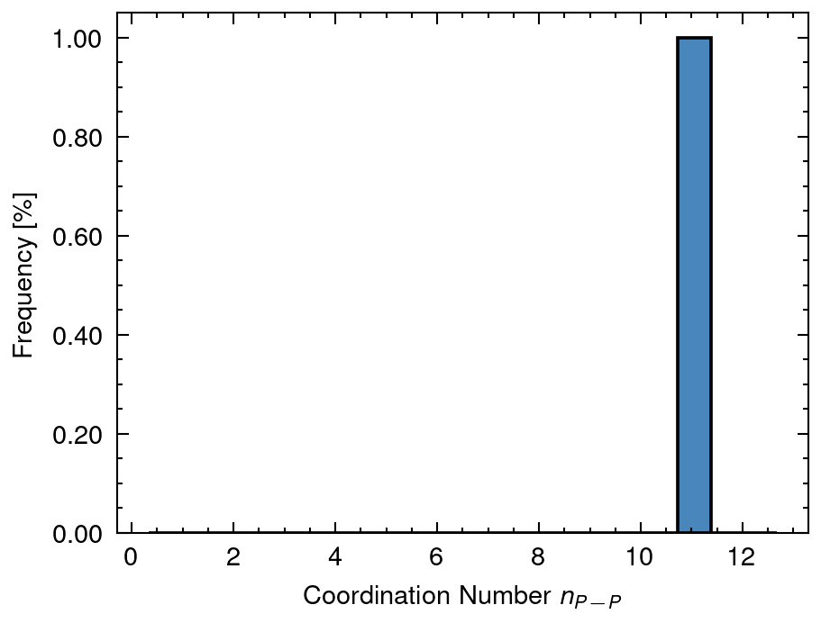
1 Distribution of input data
DA mean: 20.0 sd:0.0
DAP mean: 34.0 sd:0.0
DAPh mean: 12.5 sd:4.99
DP mean: 10.0 sd:13.86
dA mean: 2.88 sd:0.0
dP mean: 2.77 sd:0.0
fA mean: 0.6 sd:0.0
nAA mean: 5.8 sd:0.11
nAP mean: 0.92 sd:0.24
nPA mean: 0.65 sd:0.14
nPP mean: 11.15 sd:0.09

Slide 8
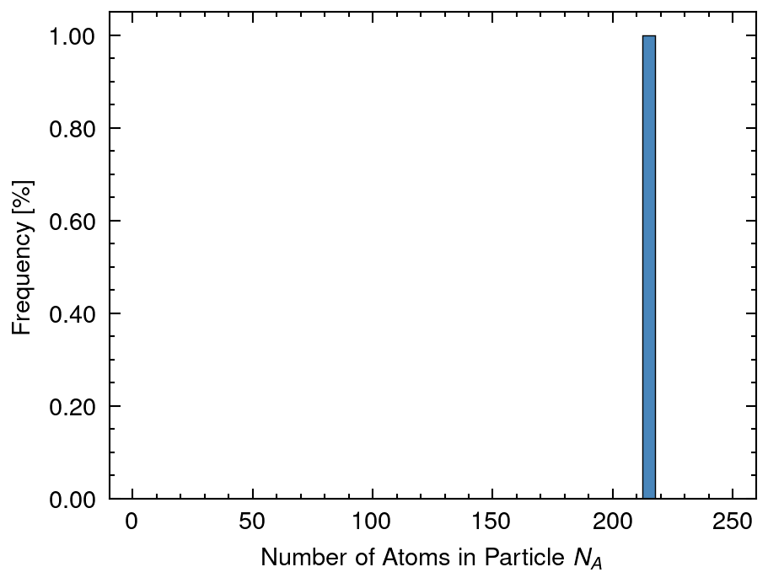
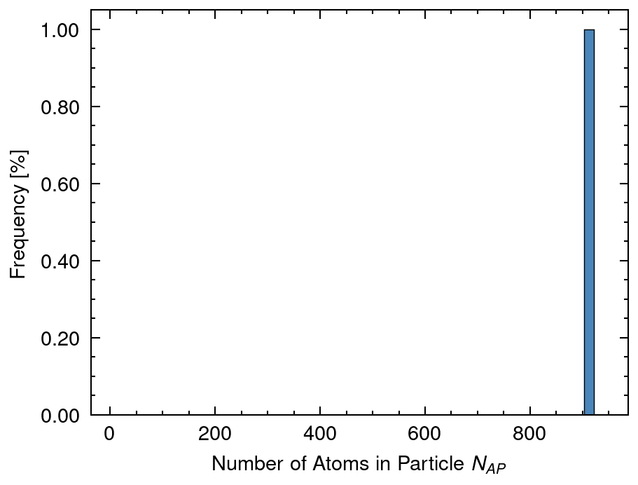
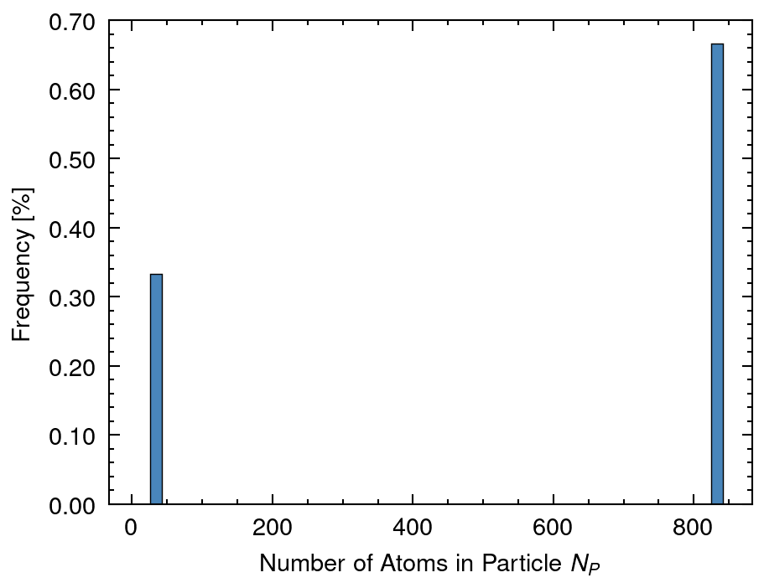
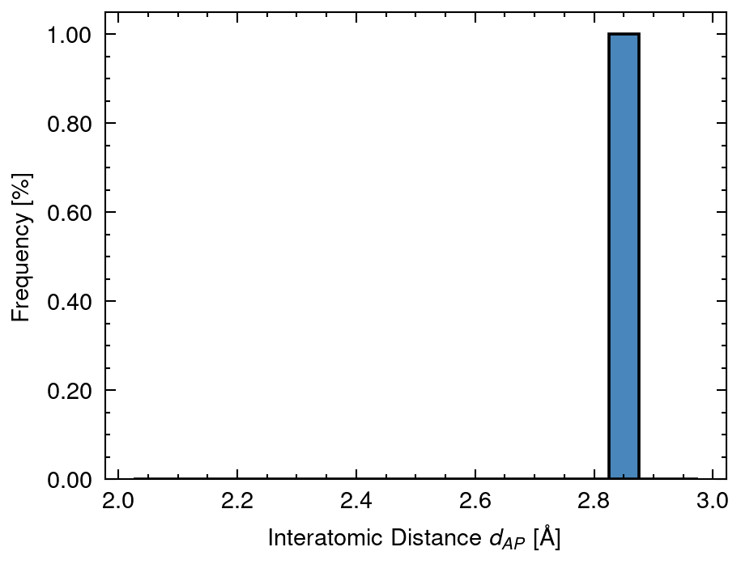
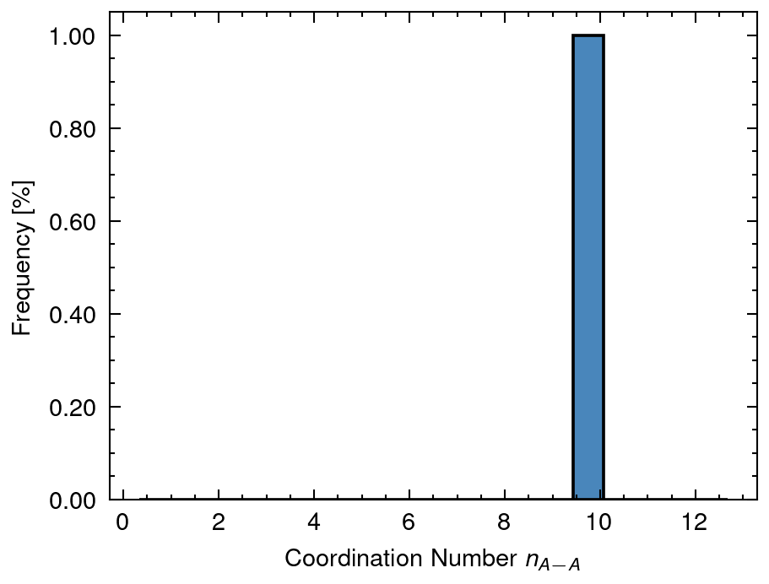
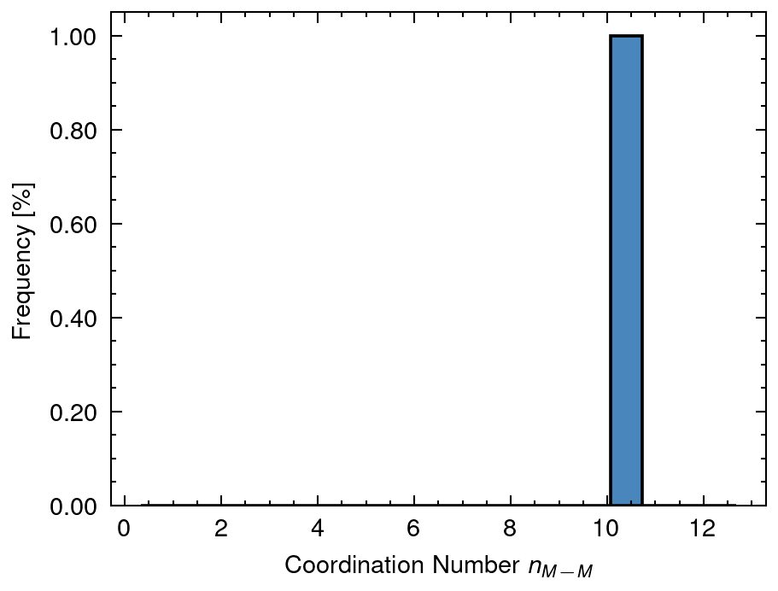
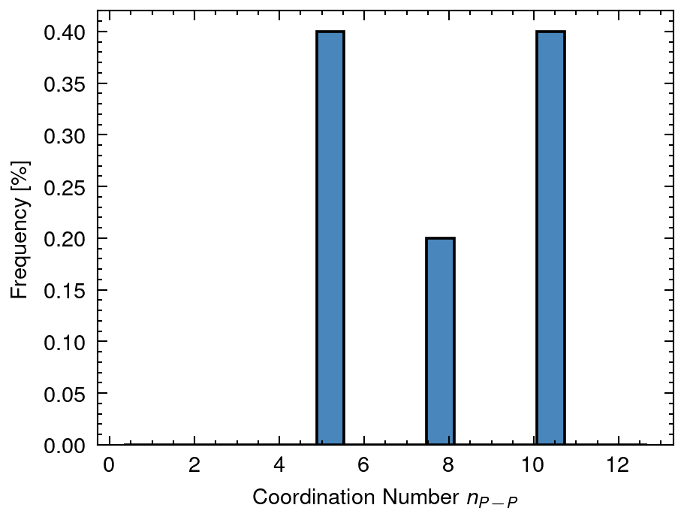
2 Distribution of calculated data
NA mean: 213.55 sd:0.0
NAP mean: 920.61 sd:0.0
NP mean: 213.44 sd:381.5
dAP mean: 2.84 sd:0.0
nAA_A mean: 9.76 sd:0.0
nMM_AP mean: 10.62 sd:0.0
nPP_P mean: 4.95 sd:4.54

Slide 9
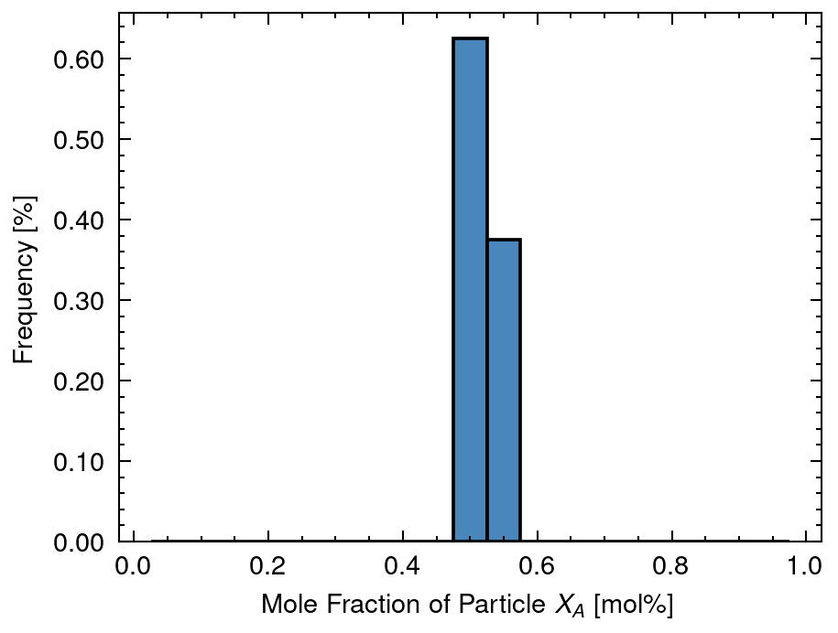
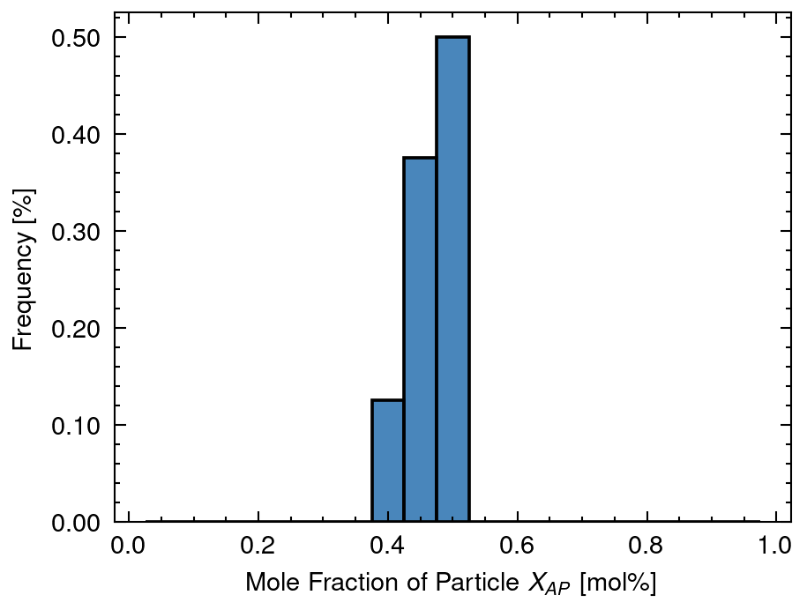
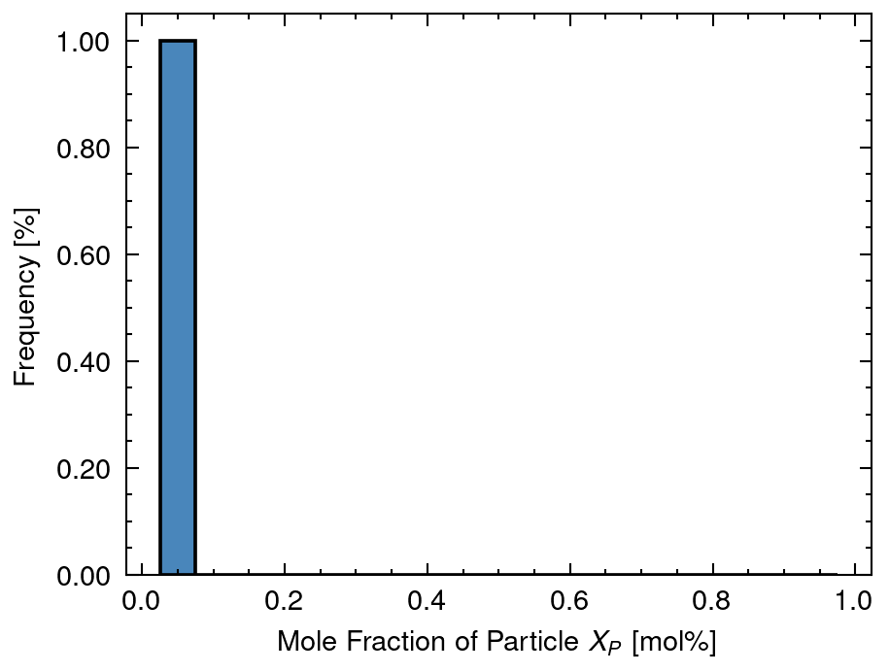
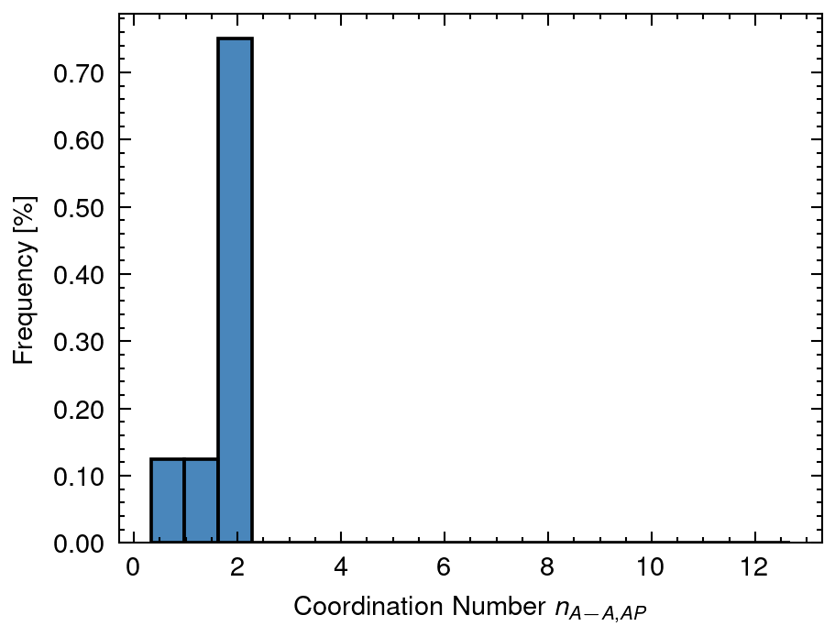
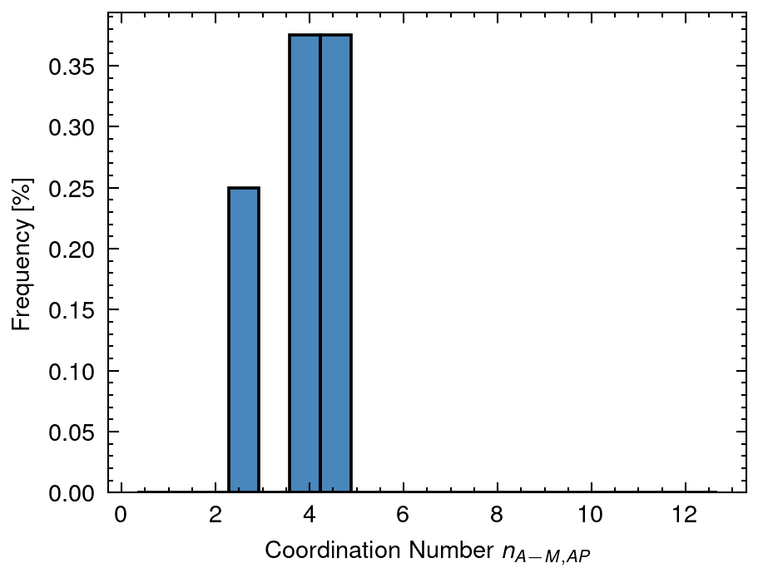
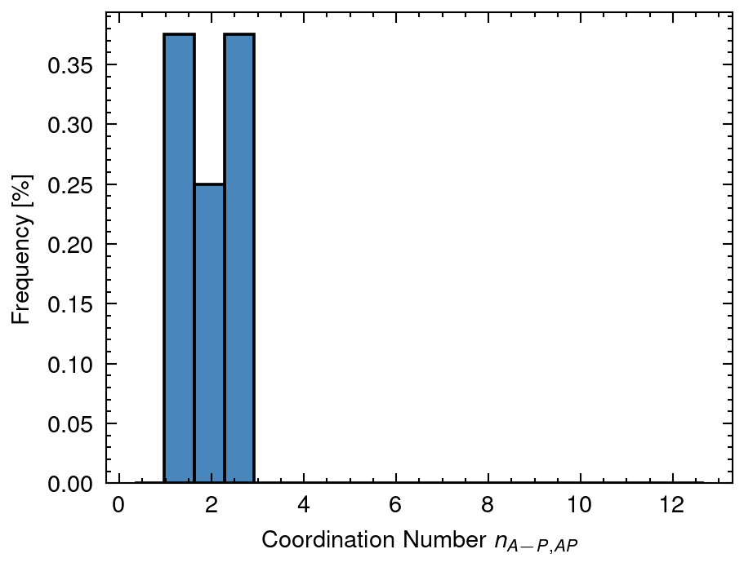
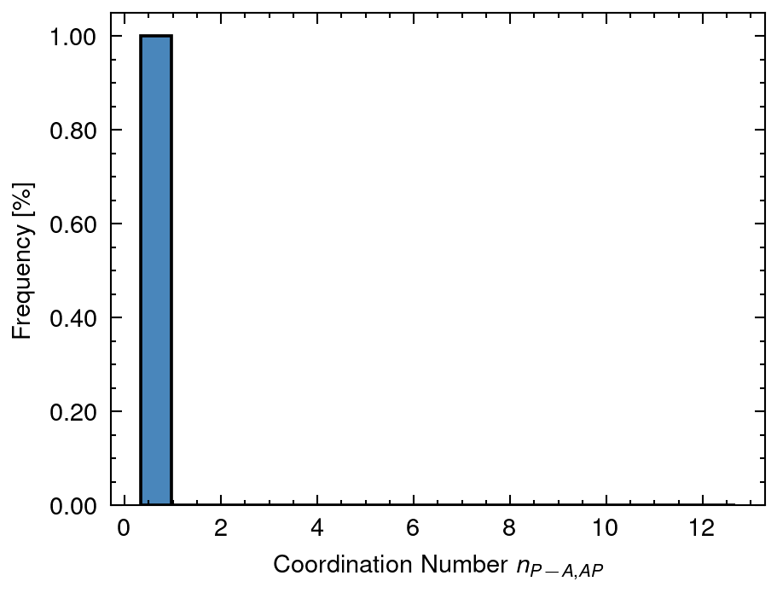
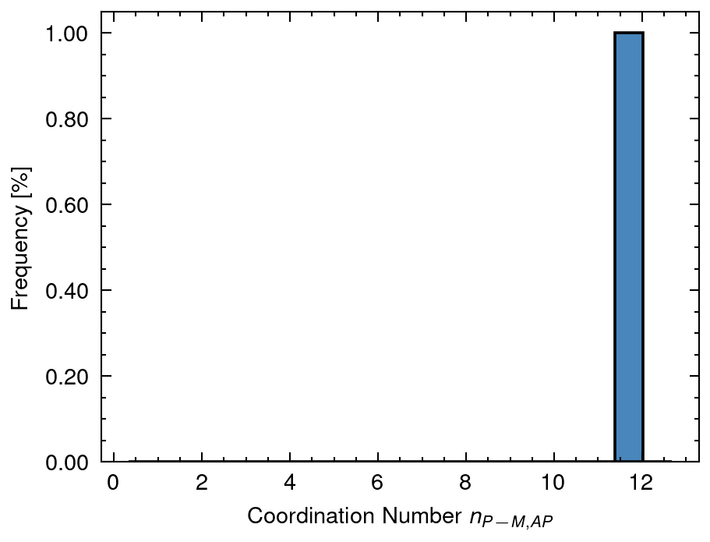
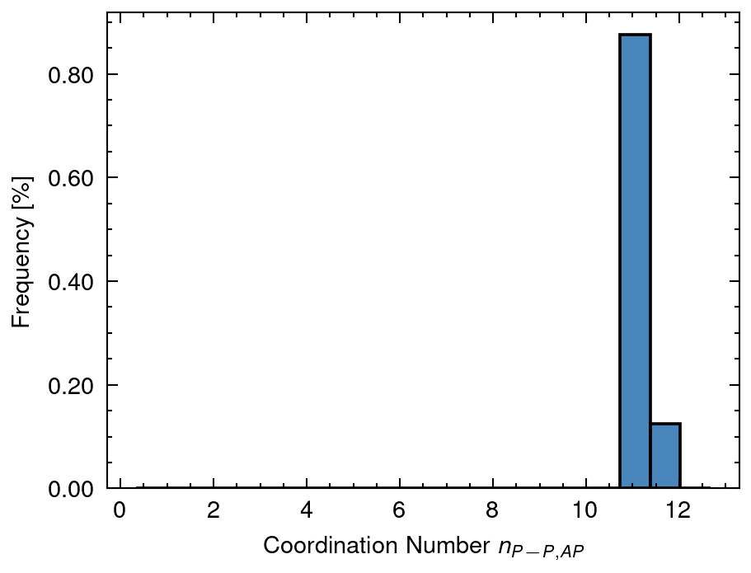
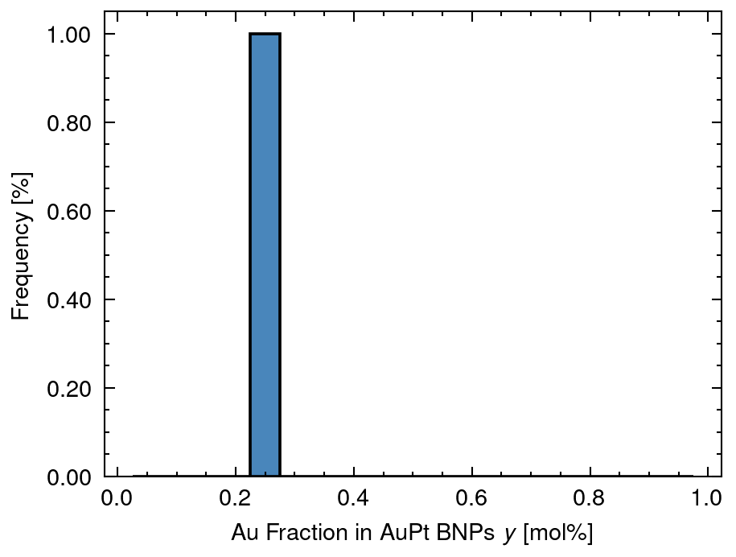
3 Distribution of solved data
XA mean: 0.52 sd:0.02
XAP mean: 0.46 sd:0.03
XP mean: 0.01 sd:0.02
nAA_AP mean: 1.8 sd:0.55
nAM_AP mean: 3.77 sd:0.83
nAP_AP mean: 1.97 sd:0.49
nPA_AP mean: 0.67 sd:0.13
nPM_AP mean: 11.88 sd:0.13
nPP_AP mean: 11.22 sd:0.12
y mean: 0.26 sd:0.01

Slide 10
4 Distribution of n (Overall Cordination Number)
nAA_A mean: 9.76 sd:0.0
nMM_AP mean: 10.62 sd:0.0
nPP_P mean: 4.95 sd:4.54

Slide 11
5 Distribution of X (Fraction of Nanoparticle)
XA mean: 0.52 sd:0.02
XAP mean: 0.46 sd:0.03
XP mean: 0.01 sd:0.02

Slide 12
6 Distribution of y (Fraction of Au in Nanoparticle)
y mean: 0.26 sd:0.01

Slide 13
7 Distribution of D (Diameter of Nanoparticle)
DA mean: 20.0 sd:0.0
DAP mean: 34.0 sd:0.0
DAPh mean: 12.5 sd:4.99
DP mean: 10.0 sd:13.86

Slide 14
8 Distribution of n (Coordination Number of Nanoparticle)
nAA_AP mean: 1.8 sd:0.55
nAM_AP mean: 3.77 sd:0.83
nAP_AP mean: 1.97 sd:0.49
nPA_AP mean: 0.67 sd:0.13
nPM_AP mean: 11.88 sd:0.13
nPP_AP mean: 11.22 sd:0.12

